Slide 1


Nurturing STEM Pathways:
Investigating STEM Engagement of Young Men of Color
Jaiah Steele
August 1, 2023

Slide 2
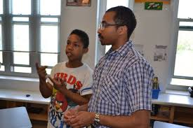
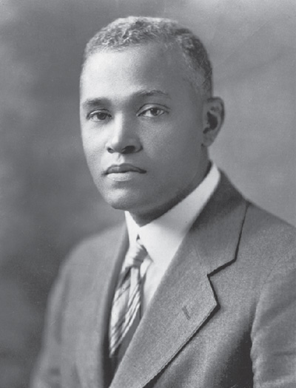
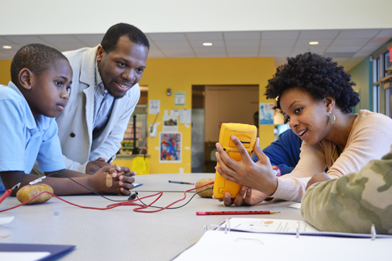
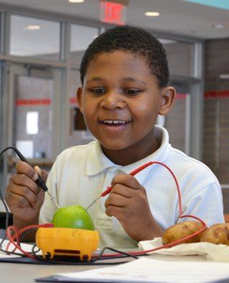
Overview
Introduction
Purpose
Research question
Methods​
Findings
Recommendations​
Acknowledgements​
Questions

Slide 3

Introduction

Slide 4
Introduction
There is an increasing acknowledgment of the importance of promoting STEM education, particularly among underrepresented groups (Starr et al., 2020)
Among those underrepresented are young men of color
Black and Latino men continue to be underrepresented in STEM fields (Funk & Parker, 2018; Roy, 2018)
Ethnicity | % All STEM Bachelor’s Degrees | % U.S. Population (age 18-34)
Black | 9% | 14%
White | 58% | 54%
Asian American | 12% | 6%
Hispanic | 17% | 22%

Slide 5
Introduction
To address these challenges, one potential avenue is the implementation of after-school programs explicitly designed to enhance STEM engagement and identity development among this demographic.
Moreover, beyond academic learning, after-school programs can play a pivotal role in fostering identity development among underrepresented groups in STEM (Henderson, 2021)

Slide 6
Purpose
To investigate and build upon the previous research of the role of the St. Elmo Brady STEM Academy (SEBA), an afterschool STEM program, in fostering STEM interest and identity development among young men of color

Slide 7
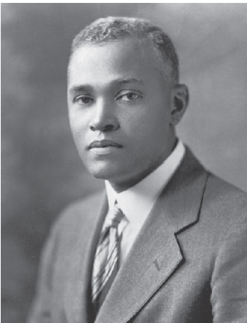
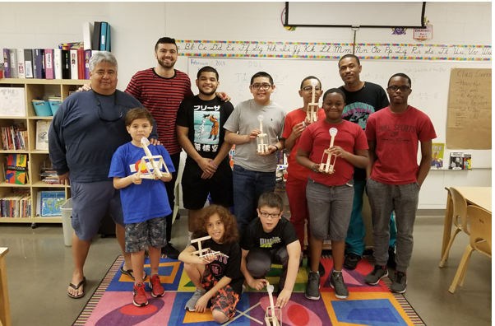
St. Elmo Brady STEM Academy
Established in 2013
Named after the first African American in the U.S. to earn a Ph.D. in chemistry
Introduces fourth and fifth grade students from underrepresented backgrounds to STEM
Uses hands-on experiments and inquiry-based learning to hone critical thinking and cooperative learning skills.
8 weeks per semester after-school sessions (2 per week) & Saturdays
Exposes participants to STEM role models (e.g. including students studying STEM at universities and community volunteers), all while fostering connections with the students' families

Slide 8
Research Question:
How do past participants of an after-school STEM program describe assets that contributed to continued STEM participation?

Slide 9
Methods

Slide 10
Methods – Data Collection
Qualitative approach (semi-structured interviews)
Recruitment email sent out to past SEBA participants' parents
Demographic Information collected from previous participants' applications (e.g., race/ethnicity & current attending school grade)
Rapport established by meeting participants parents beforehand
Interview recorded and transcribed by external transcription service
Analyzed using an Interpretative Phenomenological Analysis Approach (Smith & Nizza, 2022)

Slide 11
Semi-Structure Protocol
Consisted of introductory question and body questions
Introductory questions (e.g., demographic info – age, high school, ethnicity etc.)
Body questions (e.g., to participants' aspirations, inspirations, and current relationships with STEM).
Questions such as:
What are your future career goals, and are you planning to attend university? If so, why?
How have your parents and family supported your academic endeavors, particularly in STEM?
Outside of your family, who had the largest impact on your academic journey?

Slide 12
Interpretive Phenomenological Analysis
(Smith & Nizza, 2022)
“IPA is a method designed to understand people’s lived experience and how they make sense of it in the context of their personal and social worlds” (Smith et al., 2009)
Iterative Process
Reading & re-reading and Exploratory Notes
Formulating Experiential Statements
Finding Connections
Clustering Experiential Statements
Compiling Personal Experiential Themes
Grouping Experiential Themes (single cases)
Move to cross case analysis --> Group Themes

Slide 13
Positionality
The primary author of this study is a mixed-race male and an engineering student
Outsider to the St. Elmo Brady STEM program
All collaborators have obtained and/or seeking a degree in engineering
Shared identities of race, ethnicity and culture allowed for rapport building and insider perspective during data analysis (Bernal, 1998; Green, Crewswell, Shope, & Clark, 2007; Warren & Vincent, 2001)

Slide 14
Participants (n=3)
Name | Ethnicity | Rising School Grade
Julian | Hispanic | 12th Grade
Arlo | Hispanic | 9th Grade
Sid | Black | 7th Grade

Slide 15
Findings

Slide 16
Findings
Theme | Brief Definition
Persistence and Growth in STEM | The methods students use to gain confidence in STEM
Enjoyment and Confidence as Catalysts for Increased Participation | The notion that fun and enjoyment play roles in students' interest and participation in STEM
Sources of Inspiration | The influences and inspiration students receive in shaping STEM interest
Language and Cultural Connection | Language skills and cultural connections impacts students' understanding and engagement with STEM

Slide 17
Persistence and Growth in STEM
Highlights how students persist and excel in their STEM learning journey
Seeking help from peers and teachers,
Appreciating the impact of early exposure to STEM program
Using media as supplemental instruction

Slide 18
Persistence and Growth in STEM
“If I needed to teach or be taught something, I would quickly show my friend how to do this thing. I have some friends in my science classes that I would also be able to work things out with in class. Yes, I find that it’s very productive.” – Julian Seeking Help
“Not a lot of teachers at my elementary school at that time taught the subjects that we were learning in STEM, and I do feel confident in pursuing a career or studying STEM topics because of my exposure to the afterschool STEM program.” – Julian Appreciating The Impact
“I’ll ask my friends. If they don’t get it or I’m still not understanding from them, then I do actually turn to YouTube. If that doesn’t work, then I’ll ask the teacher.” – Julian Using Media
Takeaway: Participants determination and proactive approach to learning demonstrate a commitment to growing in STEM fields

Slide 19

Enjoyment and Confidence as Catalysts for Increased Participation
Highlights how finding joy and pleasure in math and science classes have impacted engagement and academic performance
Passion for specific STEM fields is driven by enjoyment of the subject matter
A fun and enjoyable learning environment can serve as a catalyst for students' enthusiasm and continued interest in STEM

Slide 20
Enjoyment and Confidence as Catalysts for Increased Participation
“I love working through science classes and everything. I love understanding and learning about the ocean” – Julian
“...out of like what I’ve been interested in pursuing, it’s been marine biology or computer science… I know that the career that I want to pursue has to deal with – like it deals a lot with STEM actually.” – Julian Passion
“[The program] shaped it to make it seem, as I said, more understandable and kind of fun… and made it very enjoyable which shaped me seeing it as a more fun learning experience which I could enjoy a lot.” – Arlo
“I think that math can be pretty fun … it’s really interesting trying to find, getting from Point A of the equation to Point B. Science has always been as interesting as it’s been fun for me… I always enjoy what I do in my classes.” – Julian Fun and Enjoyment
Takeaway: fun and enjoyment play significant roles in increasing students' interest and participation in STEM subjects. Participants express a passion for specific STEM fields, such as marine biology, computer science, and psychology, driven by their enjoyment of the subject matter

Slide 21
Sources of Inspiration
Highlights the influences and inspirations students receive
Parents’ involvement and encouragement in STEM
Media influence
Afterschool programs

Slide 22
Sources of Inspiration
“I feel like it started off with my parents, but as time went on, my own interest and other factors like the afterschool program have really built on that. So, as time goes by, it just keeps building and building.”- Julian
“Them also being in like – like my mom being in science, she was a lot more willing to help and stuff because science is a thing that she does and made me interested in it in a different way, but still being interested. It helped with me learning more about it.” – Arlo
“Sometimes my parents help me with [math problems], and sometimes, I got it on my own.” – Sid
“Both my parents have delved into science topics. Like my dad was briefly a professor at U of H teaching a Physics class, and as I stated before, my mom is a professor teaching Biology. So, it was also them who, I guess, inspired me. They’re definitely supportive of my decision to learn more about these STEM topics since they, themselves, have studied and worked towards these topics. I also feel like I’m sort of – it feels like it’s passed down.” – Julian Parents’ Involvement
“I would occasionally watch documentaries with my dad. I now sometimes, guilty pleasure, look at history and science documentaries and those have definitely influenced me.” – Julian Media Influence
“I feel like it started off with my parents, but as time went on, my own interest and other factors like the afterschool program have really built on that. So, as time goes by, it just keeps building and building.”- Julian Programs
Takeaways: Inspiration for STEM is a spectrum of different sources, such as parents, media and extracurricular programs

Slide 23
Language and Cultural Connection to STEM
Julian highlights how language skills and cultural connections impacts his understanding and engagement with STEM subjects.
"I feel like because I can understand two languages, I find that like Spanish is very much tied to Latin. It’s a Latin-based language, so understanding things like taxonomic names for animals, I can see or, I guess, understand better why an animal has a certain name because of the Latin roots." - Julian
Takeaway: Julian's ability to understand Spanish and its Latin roots enhances his comprehension of scientific terms, fostering a deeper appreciation and connection to STEM disciplines.

Slide 24
Discussion

Slide 25
Discussion
Every participant attributed their greatest influence on their academic interests to their parents, more specifically, their mothers.
Often, participants cited the accessibility of their parents when they come across a math or science question they could not solve.
Sources of media for influence supplemental instruction of STEM, (i.e., documentaries, Youtube)
Students’ eagerness to participate may be higher when activities are perceived as enjoyable and fun.
The perception of STEM subjects as fun likely increases student engagement in STEM-related activities.

Slide 26
Conclusions/ Recommendations

Slide 27
Recommendations
Develop hands-on STEM clubs or workshops that allow students to explore their interests in robotics, coding, engineering, or other STEM-related fields.
Integrate gamification elements into STEM lessons to make learning enjoyable and engaging, such as interactive quizzes, educational games, and rewards for achievements.
Establish peer-led study groups focusing on challenging STEM subjects, encouraging collaborative learning and problem-solving.
Establish partnerships with community organizations that focus on underrepresented groups in STEM, promoting outreach and opportunities for these students.
Develop a STEM resource center or library, offering a wide range of books, materials, and online resources to support students' curiosity and research.

Slide 28
Limitations
Findings not generalizable to ALL middle/high school students
Findings may not be generalizable to different programs – such as those that serve coed or just girls.
Participants were all children of UH faculty
Need more participants, specifically from afterschool programs outside of Houston
Three here

Slide 29
References

Slide 30
References
Yosso, T. J. (2005). Whose culture has capital? A critical race theory discussion of community cultural wealth. Race Ethnicity and Education, 8(1), 69–91. https://doi.org/10.1080/1361332052000341006
Tolbert Smith, D., Jones, T., & Cardella, M. E. (2022). A Narrative Investigation of Black Familial Capital that Supports Engineering Engagement of Middle-School-Aged Youth. Journal of Pre-College Engineering Education Research (J-PEER), 12(1), Article 2. https://doi.org/10.7771/2157-9288.1308
Burt, B. A., & Johnson, J. T. (2018). Origins of early STEM interest for Black male graduate students in engineering: A community cultural wealth perspective. School Science and Mathematics, 118(6), 257–270. https://doi.org/10.1111/ssm.12294
Maltese, A. V., & Tai, R. H. (2009). Eyeballs in the Fridge: Sources of early interest in science. International Journal of Science Education, 32(5), 669–685. https://doi.org/10.1080/09500690902792385
Maltese, A. V., Melki, C. S., & Wiebke, H. (2014). The Nature of Experiences Responsible for the Generation and Maintenance of Interest in STEM. Science Education, 98(6), 937–962. https://doi.org/10.1002/sce.21132
Williams, K. L., Burt, B. A., Clay, K. L., & Bridges, B. (2018). Stories Untold: Counter-Narratives to Anti-Blackness and Deficit-Oriented Discourse Concerning HBCUs. American Educational Research Journal, 56(2), 556–599. https://doi.org/10.3102/0002831218802776
Peralta, C. (n.d.). Success Factors Impacting Latina/o Persistence in Higher Education Leading to STEM Opportunities. ScholarWorks. https://scholarworks.boisestate.edufacpubs/74/
Samuelson, C., & Litzler, E. (2015). Community Cultural Wealth: An Assets-Based Approach to Persistence of Engineering Students of Color. Journal of Engineering Education, 105(1), 93–117. https://doi.org/10.1002/jee.20110
Smith, D. T. (n.d.-b). A Narrative Investigation of Black Familial Capital that Supports Engineering Engagement of Middle-School-Aged Youth. Purdue e-Pubs. https://docs.lib.purdue.edu/jpeer/vol12/iss1/2/

Slide 31
References cont.
Community Cultural Wealth – Community Research Collaborative. (n.d.). https://communityresearchcollaborative.org/community-cultural-wealth/
Stewart, C. O. (2022). STEM Identities: A Communication Theory of Identity Approach. Journal of Language and Social Psychology, 41(2), 148–170. https://doi.org/10.1177/0261927X211030674
Carlone H. B., Johnson A. (2007). Understanding the science experiences of successful women of color: Science identity as an analytic lens. Journal of Research in Science Teaching, 44(8), 1187–1218. https://doi.org/10.1002/tea.20237
Dou, R., Hazari, Z., Dabney, K. P., Sonnert, G., & Sadler, P. M. (2019). Early informal STEM experiences and STEM identity: The importance of talking science. Science Education, 103(3), 623–637. https://doi.org/10.1002/sce.21499
Henderson, J., Snodgrass Rangel, V., Holly, J., Greer, R., & Manuel, M. (2021). Enhancing Engineering Identity Among Boys of Color. Journal of Pre-College Engineering Education Research (J-PEER), 11(2), Article 2. https://doi.org/10.7771/2157-9288.1311
Jett, C. C. (2023). Exploring Black Males&apos; STEM Trajectories: The Crucial Role of their Black Fathers. Journal of Women and Minorities in Science and Engineering, 29(5), 47–64. https://doi.org/10.1615/jwomenminorscieneng.2023043075
Starr, C. R., Hunter, L., Dunkin, R. C., Honig, S. E., Palomino, R., & Leaper, C. (2020). Engaging in science practices in classrooms predicts increases in undergraduates’ STEM motivation, identity, and achievement: A short‐term longitudinal study. Journal of Research in Science Teaching, 57(7), 1093–1118. https://doi.org/10.1002/tea.21623

Slide 32
Questions?

Slide 33


Thank You
Jaiah Steele
jmsteele@uh.edu

Slide 34




Team Acknowledgements
Name
Name
Name
Name
Title
Title
Title
Title

Slide 35
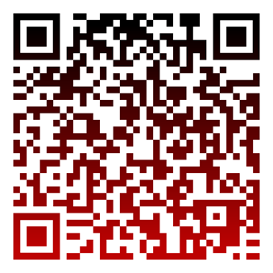
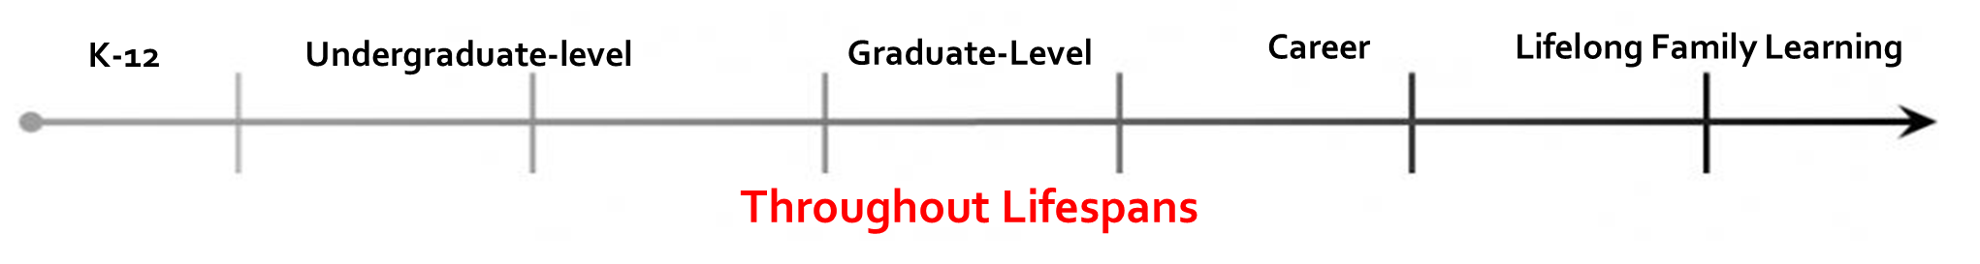
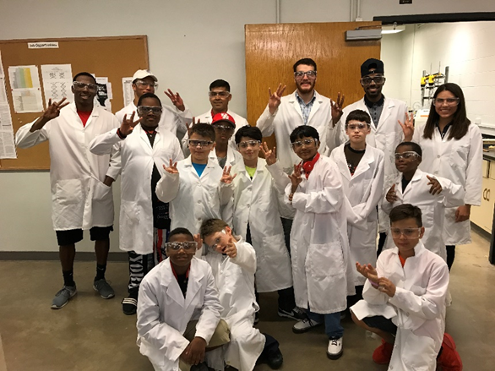
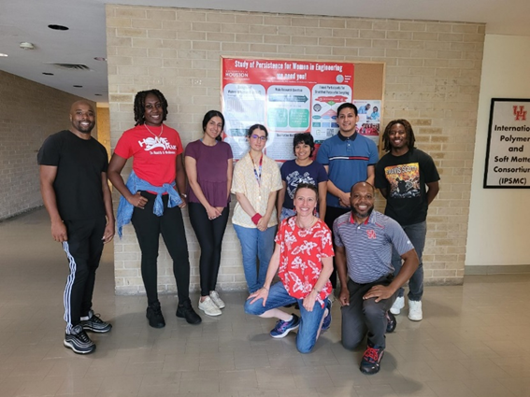

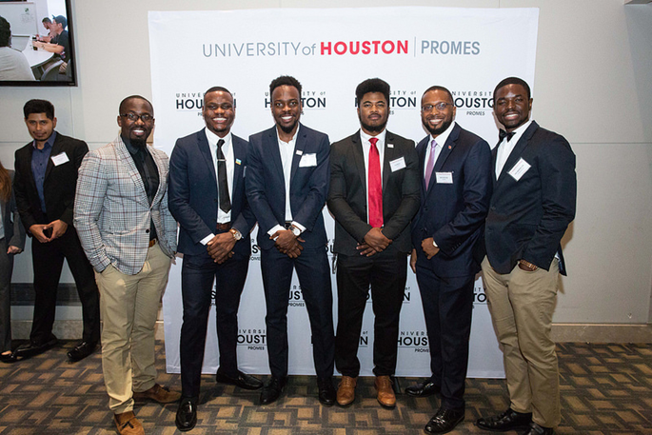
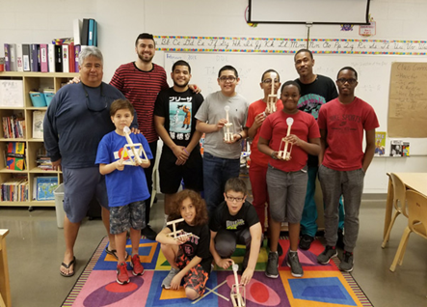
Henderson Research Group
Investigate engineering identity development among Black men and their participation in engineering throughout lifespans
Seek to understand engineering student success mechanisms using assets-based approaches
Develop interventions to improve student success
Provide guidance to institutions that are engaged in diversity, equity, and inclusion work on best practices
Use novel methods for data collection and analysis (IPA, Photovoice, Draw-an-Engineer

Slide 36
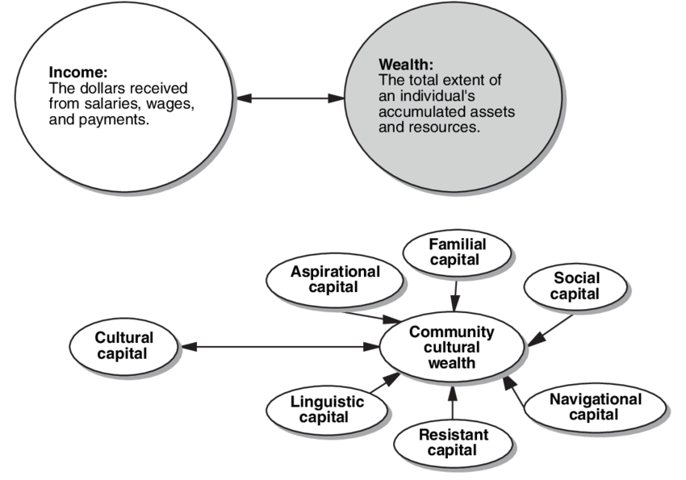
Community Cultural Wealth
(Yosso, 2005)
A
Aspirational
L
Linguistic
F
Familial
S
Social
N
Navigational
R
Resistance
From Conceptualizing a Critical Race Theory in Sociology, Tara J. Yosso and Daniel Solorzano

Slide 37
Community Cultural Wealth
(Yosso, 2005)
The cultural capitals are defined as the following:
Aspirational – the capacity to hold onto hope and aspirations for the future despite tangible and perceived barriers.
Familial – refers to the acquired knowledge and practices promoted and nurtured by family.
Linguistic – encompasses the use of multiple languages and various forms of communication, such as storytelling customs, artistic expressions, musical compositions, and poetic creations.
Navigational – comprises the understanding and strength to maneuver through oppressive and marginalizing systems with resilience and adaptability.
Resistance – the wisdom and competencies acquired by marginalized communities across generations through their resilience and persistent struggle against inequality and oppression.
Social – encompasses the social and communal connections and the wealth of resources that can be accessed through them.

Slide 38
STEM Identity
(Carlone & Johnson, 2007)
The STEM identity frameworks is made up of three components: competence, performance, and recognition.
Competence – describes one’s knowledge and understanding of STEM
Performance – describes one’s engagement in various STEM practices
Recognition – external and self perception as a STEM person
Students who consistently demonstrate their STEM competence and receive recognition for their achievements are likely to cultivate a robust and long-lasting STEM identity.
C
Competence
P
Performance
R
Recognition

Slide 39
Framework

Slide 40
Semi-Structure Protocol
Introductory Questions
What grade are you currently going into?
Currently, what high school or middle school do you attend?
What race do you identify with?

Slide 41
Body Questions To what extent did the program contribute to shaping your decisions regarding further studies or pursuing a career in STEM, and how confident do you feel about majoring in STEM in college? Please provide a detailed explanation for your response.[SEBA] What are your future career goals, and are you planning to attend university? If so, why? What had the biggest influence on this decision? How have your parents and family supported your academic endeavors, particularly in STEM? Do you think your family had the most influence in your academic journey? If not, who were those key mentors? Outside of your family, who had the largest impact on your academic journey? Do you come from a multilingual household? If so, how has that affected your academic abilities?

Slide 42
Body Questions Cont. Do you believe any skills or knowledge you acquired from the program helped you in your math and science classes? What were these skills specifically? Do you enjoy these classes? Have you encountered any challenges or discrimination related to your minority status in your educational journey since participating in the program? How did you handle or overcome them?

Slide 43
Discussion
While Community Cultural Wealth (Yosso, 2005), and STEM Identity (Carlone & Johnson, 2007) frameworks were considered for this study, ultimately the inductive analysis associated with interpretive phenomenological analysis offered more room for personal insights and subjective interpretation of the data, as well as increased flexibility to explore unexpected insights.

Slide 44
Sources of Inspiration
“Both my parents have delved into science topics. Like my dad was briefly a professor at U of H teaching a Physics class, and as I stated before, my mom is a professor teaching Biology. So, it was also them who, I guess, inspired me. They’re definitely supportive of my decision to learn more about these STEM topics since they, themselves, have studied and worked towards these topics. I also feel like I’m sort of – it feels like it’s passed down.” - Julian

Slide 45
Literature
The study showed that students interests in STEM developed during their formative educational years which is consistent with prior work. (Maltese & Tai, 2010; Burt & Johnson, 2018)
Our findings are congruent to the conclusion that afterschool programs can be beneficial for exploration and engagement in STEM (Moreno et al., 2016)
While the importance of fathers in championing their sons' STEM interests is relevant (Jett, 2023), our findings underscore the significance of mothers' influence on their children's interest in math and science. Family members who demonstrate involvement in students' education from a young age often play a crucial role in fostering this interest (Burt & Johnson, 2018). However, it is evident that the specific role of mothers should not be ignored, as they too have a profound impact on shaping their children's curiosity and passion for STEM subjects. Acknowledging and understanding the unique contributions of both mothers and fathers in nurturing STEM interests is essential for creating a supportive environment that encourages students to persist and excel in these fields.

Slide 46
Persistence and Growth in STEM
“it was something that I would look forward to because it was an interesting class. Not a lot of teachers at my elementary school at that time taught the subjects that we were learning in STEM, and I do feel confident in pursuing a career or studying STEM topics because of my exposure to the afterschool STEM program.” - Julian
“we would have days where we would start with math, and I think it was the basics of multiplication and division, but at that time, I was still just learning about it. So, it really helped my problem-solving skills. It also, I guess, gave me an interest in what we were learning and so it motivated me to do better in these STEM classes.” - Julian

Slide 47
Persistence and Growth in STEM
“if I needed to teach or be taught something, I would quickly show my friend how to do this thing. I have some friends in my science classes that I would also be able to work things out with in class. Yes, I find that it’s very productive.” - Julian
“I think that [the program] does help me because some of the topics that I learned in middle school, I was taught about during the STEM programs in my elementary school. So, I would have more of a grasp from what they’re speaking once I go there in middle school. Yes, I do believe it does help.” - Arlo

Slide 48
Sources of Inspiration
“Them also being in like – like my mom being in science, she was a lot more willing to help and stuff because science is a thing that she does and made me interested in it in a different way, but still being interested. It helped with me learning more about it.” – Arlo
“They support it good. Like when I create stuff, sometimes my mom helps me with it.” - Sid
“Sometimes my parents help me with them, and sometimes, I got it on my own.” - Sid

Slide 49
Enjoyment and Confidence as Catalysts for Increased Participation
“...out of like what I’ve been interested in pursuing, it’s been marine biology or computer science… I know that the career that I want to pursue has to deal with – like it deals a lot with STEM actually.” - Julian
“For the longest time, I’ve dreamt of a marine biology job” - Julian
“I love working through science classes and everything. I love understanding and learning about the ocean” - Julian

Slide 50
Media Influence
“I would occasionally watch documentaries with my dad. I now sometimes, guilty pleasure, look at history and science documentaries and those have definitely influenced me.” – Julian
“I’ll ask my friends. If they don’t get it or I’m still not understanding from them, then I do actually turn to YouTube. If that doesn’t work, then I’ll ask the teacher.” – Julian

Slide 51
Enjoyment and Confidence as Catalysts for Increased Participation
“I think that math can be pretty fun when solving something. Like algebra problem-solving, it’s really interesting trying to find, getting from Point A of the equation to Point B. Science has always been as interesting as it’s been fun for me. So, yes, I always enjoy what I do in my classes.” - Julian
“I want to learn psychology because I have a curiosity of trying to figure out how the mind works or, at least, understand it, because it really fascinates me.” - Arlo
“[the program] shaped it to make it seem, as I said, more understandable and kind of fun… and made it very enjoyable which shaped me seeing it as a more fun learning experience which I could enjoy a lot.” - Arlo
“I do enjoy math a lot more than I used to because I feel like I’ve done better at retaining the learning that I have been taught and understand how to work the problems a lot more.” - Arlo

Slide 52
Language and Cultural Connection to STEM
"I feel like because I can understand two languages, I find that like Spanish is very much tied to Latin. It’s a Latin-based language, so understanding things like taxonomic names for animals, I can see or, I guess, understand better why an animal has a certain name because of the Latin roots." - Julian

